Slide 1
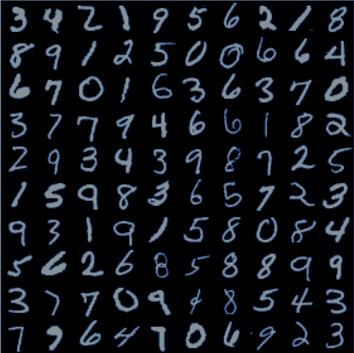
MNIST HANDWRITTEN DIGIT RECOGNITION
SQE Project

Slide 2
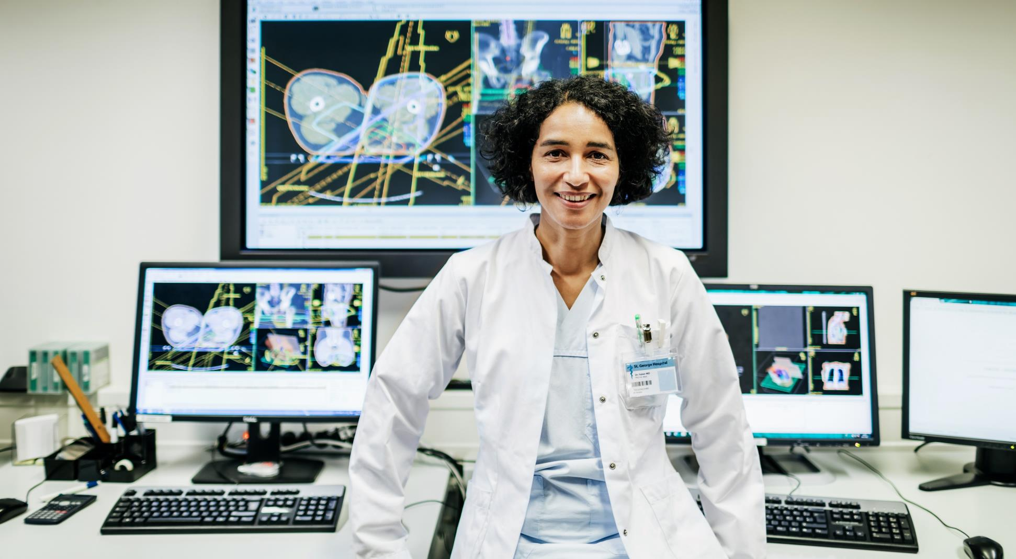
INTRODUCTION
Handwritten digits recognition could be a well-researched subarea.
Involved with learning models to differentiate pre-segmented written digits.
Main application of machine learning strategies has determined efficacious in conformist decisive systems.
In 21st century written digit communication has its own normal
Challenges in handwritten characters recognition lies within the variation and distortion of handwritten.
The challenges are principally caused by the big variation of individual writing styles.
Strong feature extraction is extremely important.
Handwritten digit recognition has obtained heap of concentration.
Character reognition system may function as a cornerstone.

Slide 3
WHICH ALGORITHM IS USED AND WHY?
Neural Network: Training and testing wad done.
CNN was found to have highest accuracy of 98%.
It was used for the model.
Both were tested for results in GUI user-based application.

Slide 4
DRY RUN OF ALGORITHM
Import the libraries and load the MNIST dataset
Data Preprocess and Normalize
Create the model
Train the model
Evaluate the model
Create GUI to predict digits

Slide 5
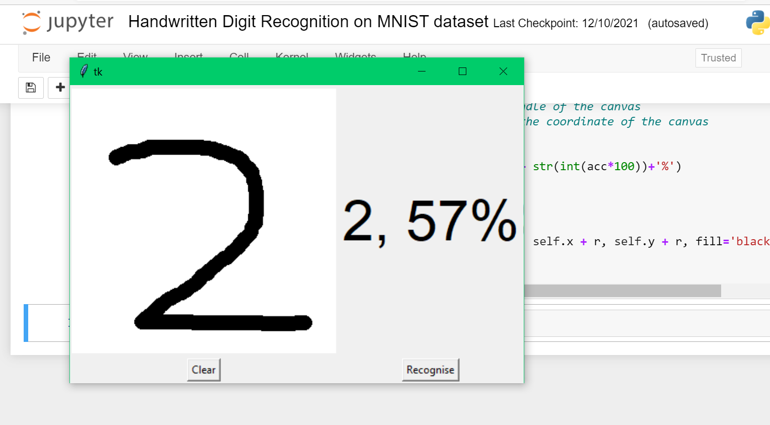
DRY RUN OF ALGORITHM
.

Slide 6
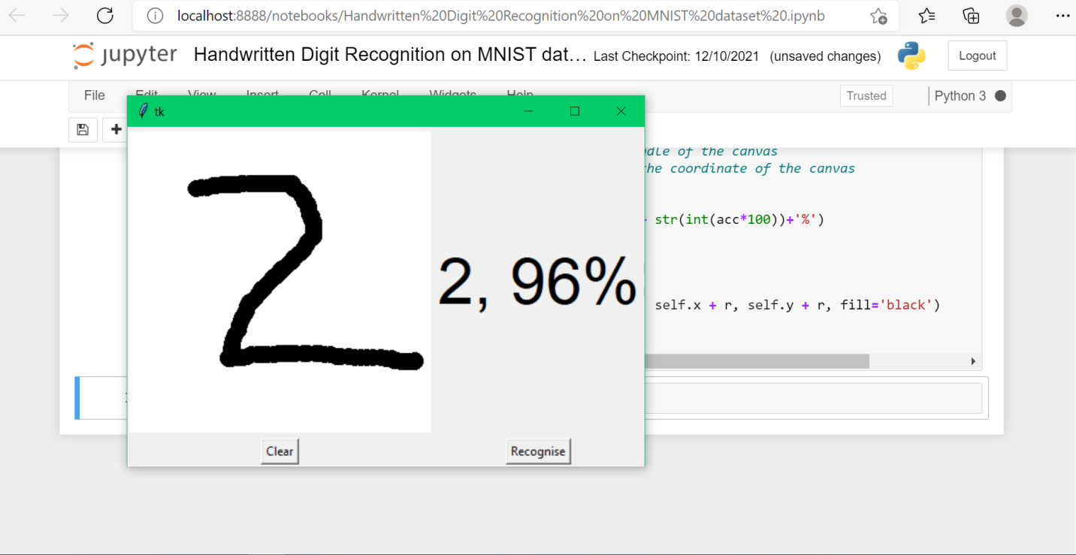
DRY RUN OF ALGORITHM

Slide 7
TOOLS AND TECHNOLOGIES USED:
We will be using a special type of deep neural network that is Convolutional Neural Networks. In the end, we are going to build a GUI in which you can draw the digit and recognize it straight away/
To achieve high performance on the handwritten digit recognition task using the MNIST dataset and build a GUI App based on Tkinter.

Slide 8
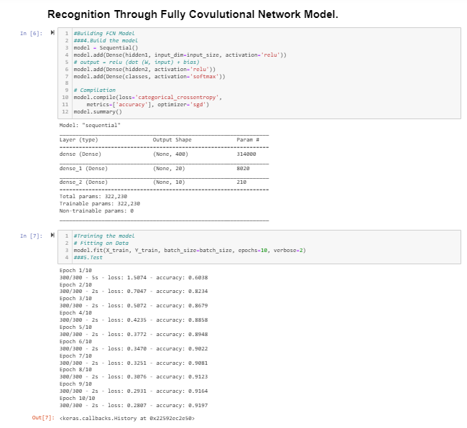
OUTPUT

Slide 9
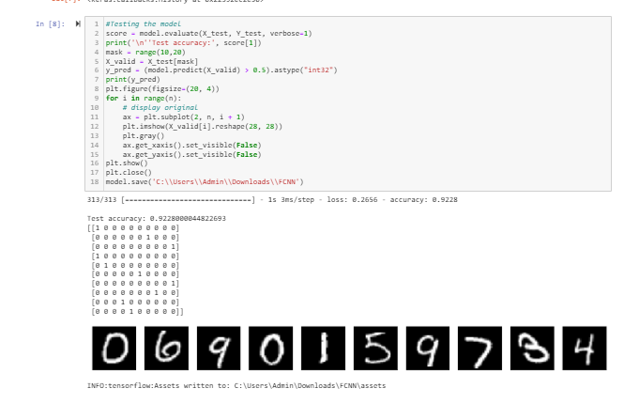
OUTPUT

Slide 10
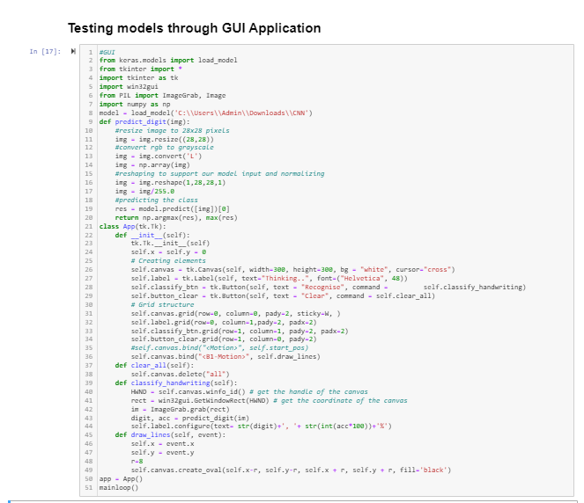
OUTPUT

Slide 11
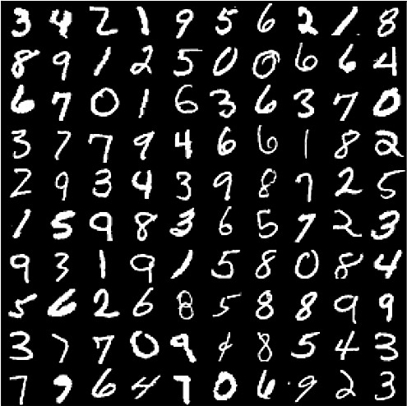
THANK YOU

